Slide 1


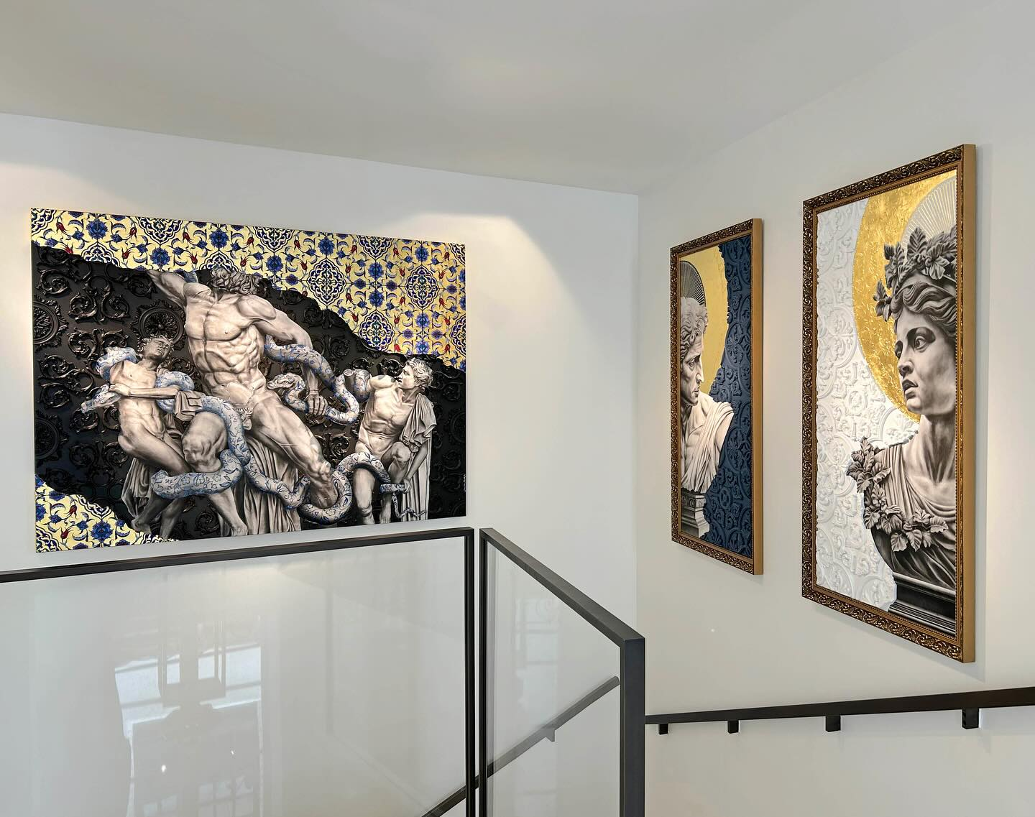

Slide 2
ACQUIRING ARTWORK
A UNIQUE MOMENT
TO MAKE THIS MAGIC POSSIBLE,
GALERIES BARTOUX OFFERS YOU:
INDIVIDUAL ADVICE AND SUPPORT
WORLDWIDE DELIVERY
#ARTWORK AT HOME : SOLUTIONS FOR PROJECTING YOUR FAVOURITE ARTWORKS IN YOUR HOME

Slide 3
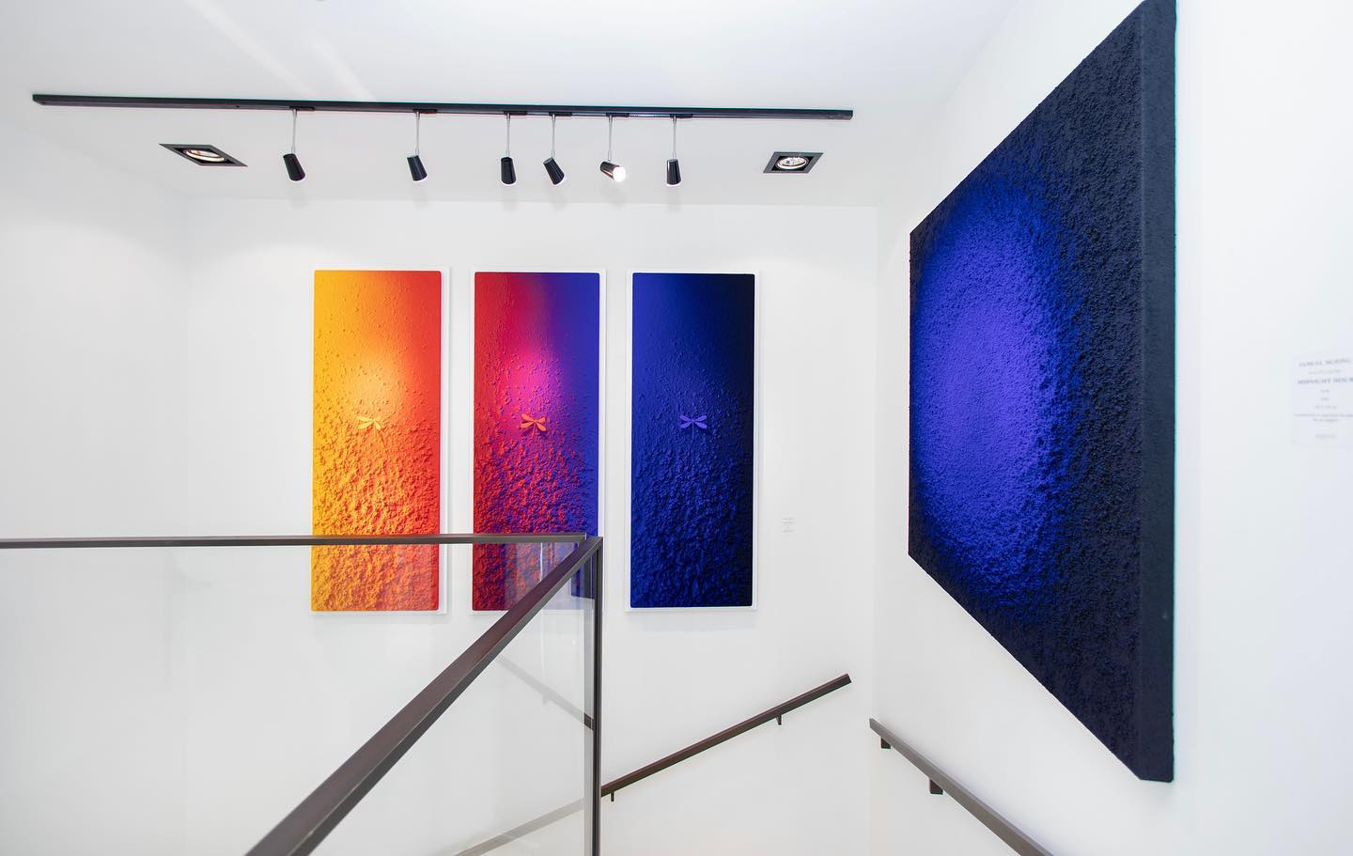

GALERIES BARTOUX
AUTHENTICITY - CONVIVIALITY - REFINEMENT - EXPERIENCE
CREATING EMOTIONS SINCE 1993
Who hasn’t been touched by a work of art? From joy to melancholy, art allows us to express and awaken an infinite range of emotions through aesthetics. Going against the grain of traditional galleries, we arouse genuine emotions in our collectors. Our artistic selection highlights the greatest talents of our time and of tomorrow, reflecting our constantly evolving society.
Like the most prestigious luxury houses, our showcases are modern, stylish and warm. As well as exhibiting unique creations, Galeries Bartoux promises an extraordinary visual and emotional experience.
BARTOUX ART & DESIGN PARIS
In our showcase at 60 rue du Faubourg Saint-Honoré, discover our selection of the best in contemporary art and design. Bartoux Art & Design promises a timeless artistic break ...
lesgaleriesbartoux

Slide 4
Come & visit
60 RUE DU FAUBOURG SAINT-HONORÉ, PARIS 8e
Let's discuss your artistic project
+33 6 38 02 07 58
Jordane Pellerin
artdesign@galeries-bartoux.com
GALERIES-BARTOUX.COM

